Slide 1



Intro
Classes
Methods
Agents
Start
PYTHON OOP → AGENTIC AI
Classes • Objects • Methods
Agent Blueprints

Slide 2


Home
Services
Features
About Us
Contact
WHY CLASSES?
We Know Functions
Functions
Organize Logic
Data Becomes
Related
Classes Keep
Them Together
What Does
It Know & Do?
Before vs.
After Classes
Functions are great for organizing actions and logic — each function does one specific job clearly and reusably.
As programs grow, data and the actions that use it naturally belong together — keeping them separate gets messy.
A class bundles both data (what it knows) and functions (what it does) into one clean, organized structure.
Ask yourself : "What does this thing know and what can it do?" That question is the key to designing a class.
Before : scattered variables and functions.
After : one class holds a student's name and their introduce() method together.

Slide 3


Home
Services
Features
About Us
Contact
Creating
a Class
Class Syntax
Blueprint → Object
class Student:
pass
• class creates a class
• Student is the class name
• pass means "nothing here yet"
• A class is a blueprint
A class is not the student itself — it is the template used to create students. One blueprint, many objects.
CLASS
BLUEPRINT
Think of a class like an architectural blueprint. The blueprint is not a house — it describes how to build one.
In Python, class Student: defines the structure. pass is a placeholder meaning the body is empty for now. From this single blueprint, you can create many individual Student objects, each with their own unique data and behavior.

Slide 4
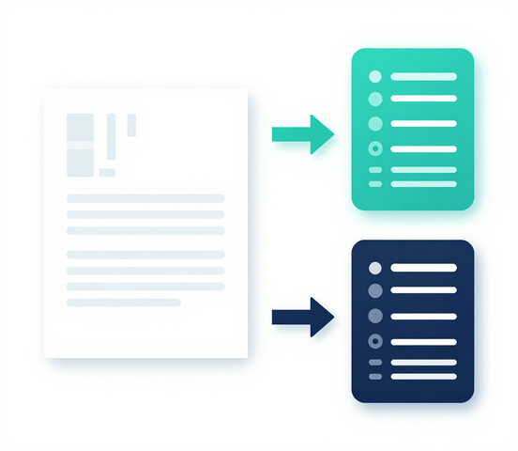
Home
Services
Features
About Us
Contact
One class can create many objects. Each object is an independent instance with its own data.
student1 = Student()
student2 = Student()
INSTANCES & OBJECT CREATION
Instance = Object
Creating Objects
An object is an instance of a class. The class is the blueprint; the object is the real thing built from it.
A single class definition can produce unlimited objects. student1 and student2 are separate instances from the same Student class.
One Class, Many Objects
Quick Check
Are student1 and student2 the same object?
Independent Data
Each object holds its own data independently. Changing data on student1 does not affect student2 — they are distinct.

Slide 5

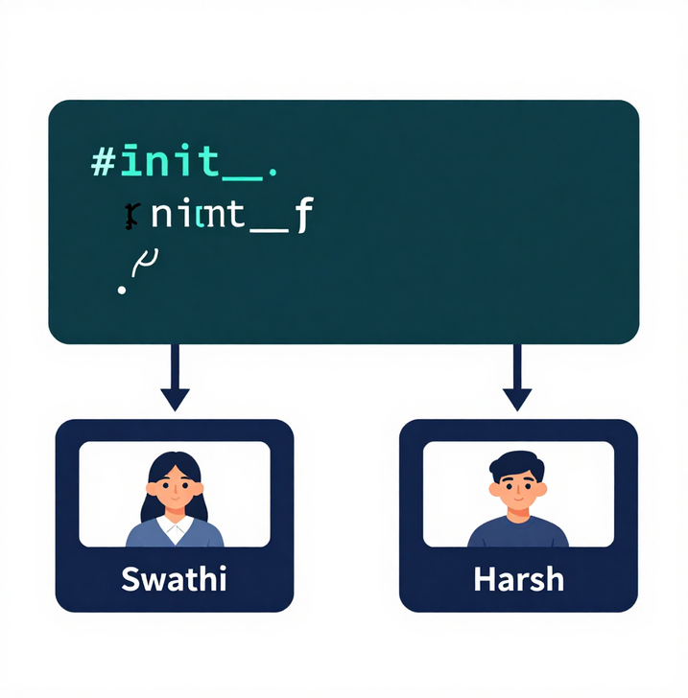
Home
Services
Features
About Us
Contact
init
& self
OBJECTS GET
UNIQUE DATA
HERE
init Method
Runs automatically when a new object is created. Sets up the object's starting data.
class Student:
def __init__(self, name):
stud1 = Student(“swathi”)
stud2 = Student(“harsh”)
self.name Attribute
The self Keyword
Creates a named attribute on the object. Each object stores its own value independently.
Refers to the current object. Lets the object refer to its own data and methods.
Blueprint in Action
Different State
One class definition creates many unique objects. The init method personalizes each one at creation time.
student1 = Student("Swathi") and student2 = Student("Harsh") share one class but hold different data.

Slide 6
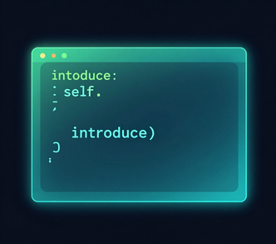
Home
Services
Features
About Us
Contact
Functions
Inside Classes
= Methods
METHODS & BEHAVIOR
A function defined inside a class is called a method. Methods give objects the ability to act, not just hold data. They define behavior.
Method
Definition
Object
Behavior
Calling
Methods
def introduce(self):
print("Hi, I'm", self.name)
A function inside a class is a method.
Methods define what an object can do. Each method uses self to access the object's own attributes and state.
student1.introduce()
Use object.method() syntax to call a method on a specific instance.
Call a method using dot notation: object.method(). Methods always receive self as the first parameter, giving them access to the object's own data.

Slide 7



Home
Services
Features
About Us
Contact
Mini Coding
Challenge
BUILD A
ROBOT
CLASS
Robot Class
Define a Robot class with init taking name and battery as parameters.
speak() Method
move() Method
Add a speak() method that prints the robot's name and a message.
Add a move() method that uses battery level to describe movement.
Two Robots
Instantiate robot1 and robot2 with different names and battery values.

Slide 8



Home
Services
Features
About Us
Contact
OOP → Agentic AI
THE CONCEPTUAL BRIDGE
A Class is the agent blueprint. An Object is an individual agent instance. Each agent holds its own state and capabilities.
Class → Blueprint
Attributes store the agent's state (memory, goals). Methods define what the agent can do — search, plan, act, summarize.
Attributes → State

Slide 9


Home
Services
Features
About Us
Contact
Study
Agent
agent.search_topic(topic) lets the agent look up any subject. The method receives a topic string and retrieves relevant information for the student.
Search
Topic
agent.create_quiz(topic) generates practice questions on any topic. Each call produces a fresh quiz to test the student's understanding.
Create
Quiz
agent.summarize(text) condenses long content into key points. The agent processes any text and returns a concise, student-friendly summary.
Summarize
Text
AGENT = STUDYAGENT("STUDYBOT")

Slide 10
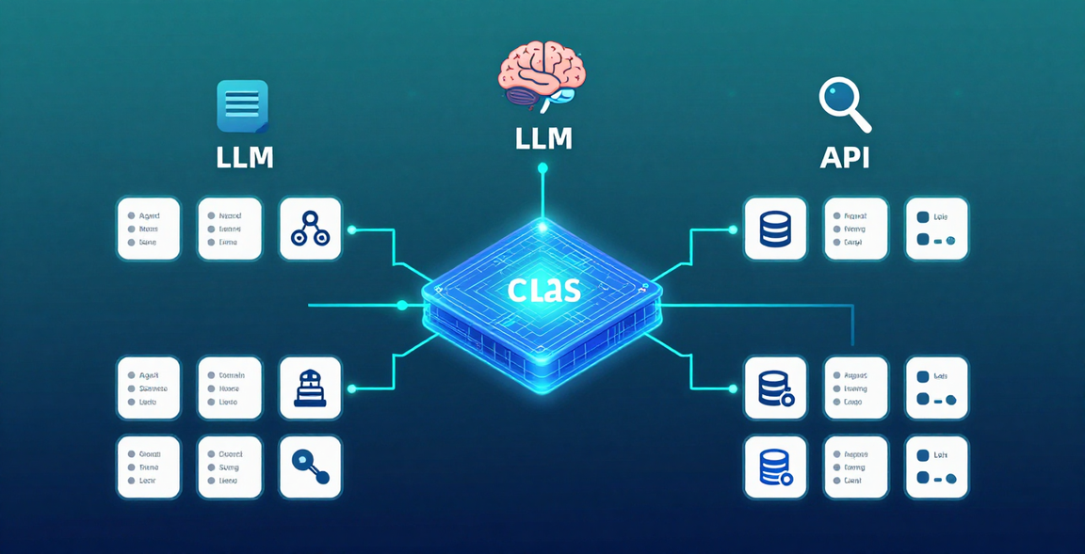


Home
Services
Features
About Us
Contact
Your Mental Model
Classes define the blueprint. Methods define behavior. Agents use the same structure.
OBJECT = STATE + CAPABILITIES
Next step: connect methods to real AI tools, LLMs & APIs.
Agent = State + Capabilities → Tools / LLM / APIs
Agentic AI Study Group — Slide 10 of 10

